Slide 1
Orientation on Information Management
May 8, 2024: 10:15 am – 11:00 am
Virtual, SATA Conference

Slide 2
Information Management in Saskatchewan PURPOSE
Role of the Audit and Information Management Branch
Access to Information
Privacy Protection
The Role of the IPC
Records Management

Slide 3
The Audit and Information Management Branch, Ministry of Justice and Attorney General
The Branch provides leadership to government institutions on access and privacy issues.
The Branch offers support to assist with compliance and consistency, including:
Developing tools and guidance documents
Providing and supporting training to institutions
Providing recommendations and non-legal advice.
Notes:
Recent amalgamation in JUSTICE
Now also have responsibilities of:
Chief Privacy Officer
Chief Access Officer
RM
Designated Officer under PIDA
Point this out because it is fairly common for many A&P officers to wear many hats
Desire to collaborate and cooperate with program areas

Slide 4
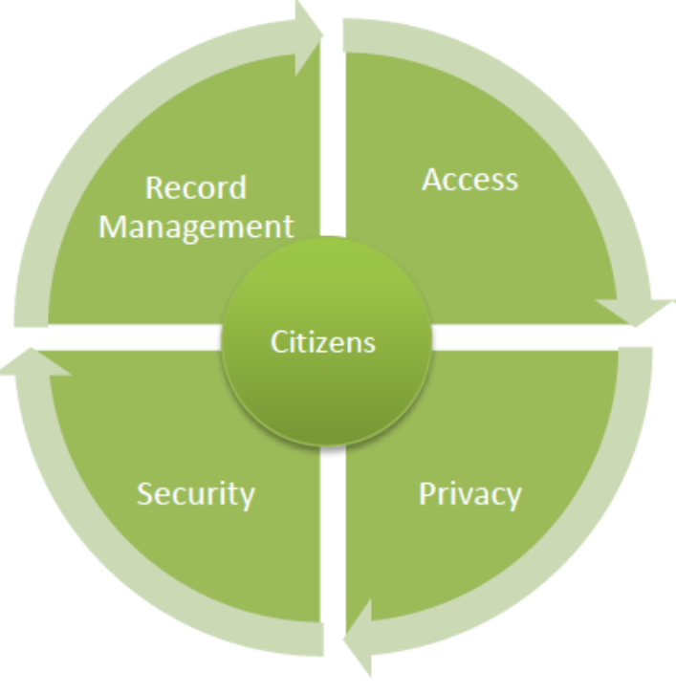
INFORMATION MANAGEMENT FRAMEWORK
Access: supporting the public’s right of access to government records.
Privacy: using best practices to support individual informational privacy rights.
Security: utilizing appropriate safeguards to protect all categories of sensitive information from threats and risks.
Records Management: ensuring public records are appropriately preserved and disposed of.
Notes:
GoS has a framework of Policies, procedures and guidance that supports this balance
Currently a bit scattered
The IMF is a holistic approach to how government uses, shares, protects and disposes of the personal and personal health information it collects.
The IMF is a joint project between JU, HE, CIC, eHealth and others with input from OIPC and Archives
Seeks to ensure policies are current and updated where need be and to make them more accessible to all GoS employees
Extend to public as bug’s are ironed out

Slide 5
LEGISLATION
Creates broad rights of access to records in the possession and control of “government institutions” subject to the exemptions to disclosure established by the Act. Creates a framework of rules that govern the collection, use and disclosure of “personal information”.
Very similar to FOIP but applies to Local Authorities.
Establishes a framework of rules that govern the collection, use and disclosure of “personal health information” by “trustees”. Creates individual rights of access and correction to personal health information.
The Freedom of Information and Protection of Privacy Act (FOIP)
The Local Authority Freedom of Information and Protection of Privacy Act (LA FOIP)
The Health Information Protection Act (HIPA)
Notes:
New Amendments are pending
Duty to Protect
Duty to Assist
New snooping offenses – increase in fines up to $50k
Police will now come under LAFOIP
Also must think about legislation that is specific to your area that has confidentiality and privacy requirements (i.e. Adoption Act, CFSA, YCJA)

Slide 6
BALANCE
Access:
the public’s right to access information in the possession and control of government with the legitimate need to withhold certain information and individual privacy rights.
Privacy:
the need to protect the personal information held by government institutions against the need to collect, use or disclose that information to fulfill our mandates.
Source: Open Government: Key Implementation Considerations, Sept. 2016, Information and Privacy Commission of Ontario
Notes:
All 3 are overarching
Apply to all our activities as government when we are CUD
Specific carve-outs for certain legislation or portions of it (Adoptions Act, CFSA, MEO Act)
All 3 laws establish:
Rights of access to information
Privacy rights
All 3 seek to balance:
GoS need to CUD individual's information in order to design and deliver services with need to protect personal infomration
GoS need to keep certain information confidential against access rights

Slide 7

ACCESS
“The overarching purpose of access to information legislation…is to facilitate democracy. It does so in two related ways. It helps to ensure first, that citizens have the information required to participate meaningfully in the democratic process, and secondly, that politicians and bureaucrats remain accountable to the citizenry.”
Justice La Forest
Dagg v. Canada (Minister of Finance, 1997)
Notes:
Over the years the Courts have found that:
Disclosure is the default
Information should be withheld on a limited basis
Exemptions to access should be used sparingly and specifically
FOIP Creates a process through which records may be accessed

Slide 8


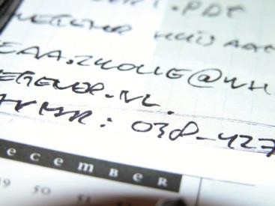

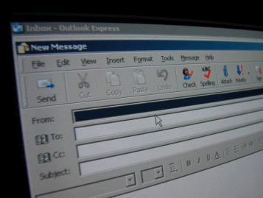
Access to records
Documents and drafts of
those documents
Letters
Handwritten notes
Email
Calendars
Notes:
FOIP is “record driven” and not “information driven”.
The right of access is to records in the possession or control of a government institution; no requirement to create records.

Slide 9
What should I do?
Create records with FOIP in mind;
Keep comments professional;
Avoid writing unnecessary comments in records; and
State views, comments and opinions as objectively as possible.
Prioritize your records management.

Slide 10

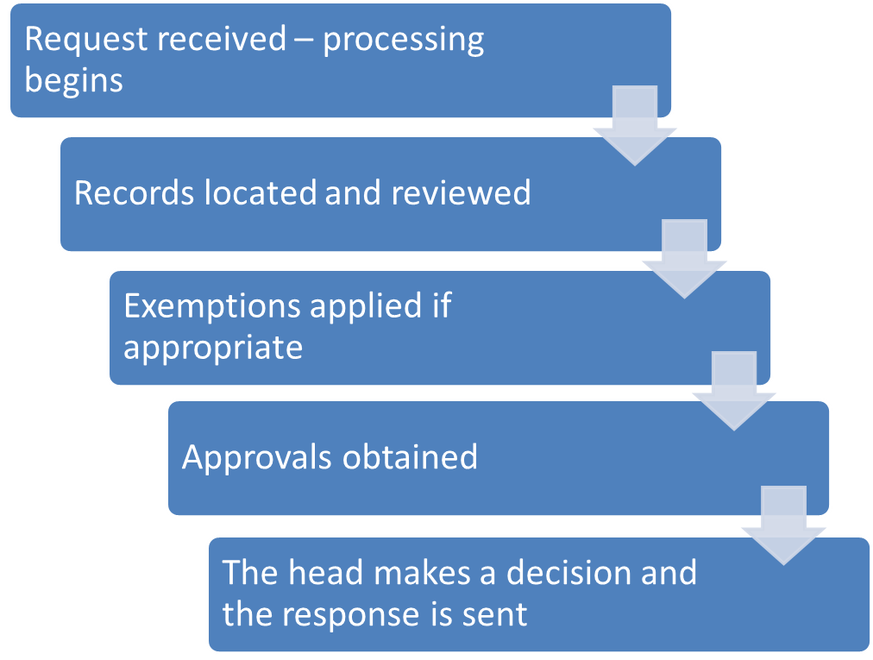
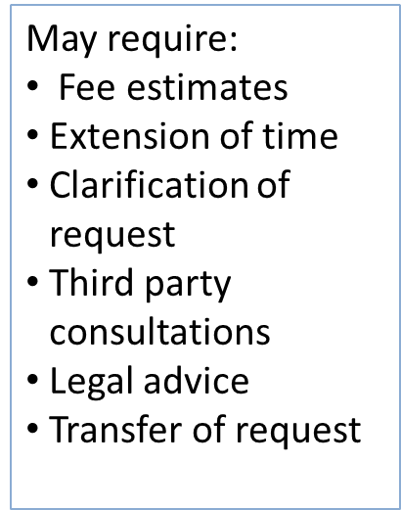
THE ACCESS TO INFORMATION (ATI) PROCESS
30 DAYS
Notes:
Anyone, from anywhere can make a requests for any record in the possession or control of a GI
Records are almost anything in any form that contains information
Important to ensure records are properly retained
Equally important to ensure they are properly disposed of
Fees may be charged and in some circumstances may be waived by the head
Decisions around access are made by the head of the GI – typically the DM or CEO

Slide 11
Exemptions
Applying exemptions involves an internal (and external if 3rd party info) consultation process.
Mandatory - the “shalls”
Third party
Personal information
Discretionary - the “mays”
Advice, proposals, recommendations
Consultations or deliberations involving government employees
Notes:
Very important for program areas to have an understanding of what the exemptions are and how they apply
Some are class based – if a record is in a class (i.e. cabinet documents) then the exemption may apply
Others are harms based – if disclosure of a record would create a harm (i.e. disclose trade secrets or technical, financial information) then an exemption may apply
Burden of proof is on the GI to show that the exemption applies
Good place to go is top the IPC Exemption Guide
Important rule of thumb with ATI is that this mostly shades of grey with a little bit of black and white

Slide 12

PRIVACY SCC in R. v. Duarte [1990]
The right to informational privacy - “The right of the individual to determine for himself when, how and to what extent he will release personal information about himself.”

Slide 13
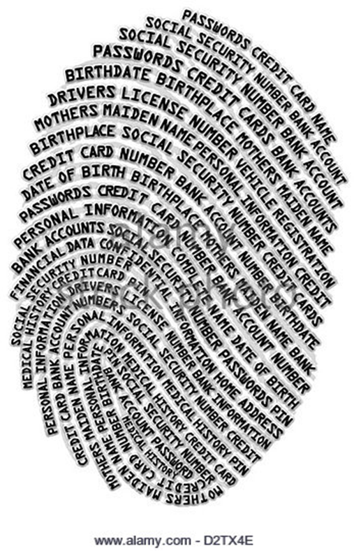
What is personal information?
Personal information is defined in FOIP as information about an an identifiable individual:
Race;
Religion;
Sexual orientation;
Employment history;
Personal opinions or views about the individual.
Personal health information is defined in HIPA and includes information about the health of an individual or health services received by that individual.

Slide 14
Protection of Privacy
FOIP and HIPA set out privacy protection rules for personal information and personal health information in government.
These include rules about how government institutions may collect, use and disclose personal information and personal health information and a “duty to protect”.
Notes:
Rules like:
Providing notice of collection and anticipated uses
Gathering consent where possible
Using only for specified purposes
Need to know principle
Duty to protect – throughout the life cycle of the information

Slide 15
An individual’s role in privacy may include…
Ensure records are protected
Administrative, physical and technical safeguards
Identify risk areas
Know what to do if a privacy incident occurs
Take the available training: http://www.saskatchewan.ca/government/training-and-workshops/access-and-privacy-training-course-for-saskatchewan-executive-government
Notes:
Administrative Safeguards:
Policies and procedures; Retention schedules; Privacy impact assessments; Training.
Technical Safeguards:
Use of strong passwords; Use an encrypted USB stick.
Physical Safeguards:
Use of a “clean desk” policy; Lock file cabinets; Secure record disposal.

Slide 16
Information and Privacy Commissioner
Independent officer of the Legislative Assembly
Provides oversight over Saskatchewan’s three ATIPP laws.
Conducts reviews of responses to access to information requests and carries out investigation into privacy breaches.
Recommendation-making authority.
http://oipc.sk.ca/

Slide 17
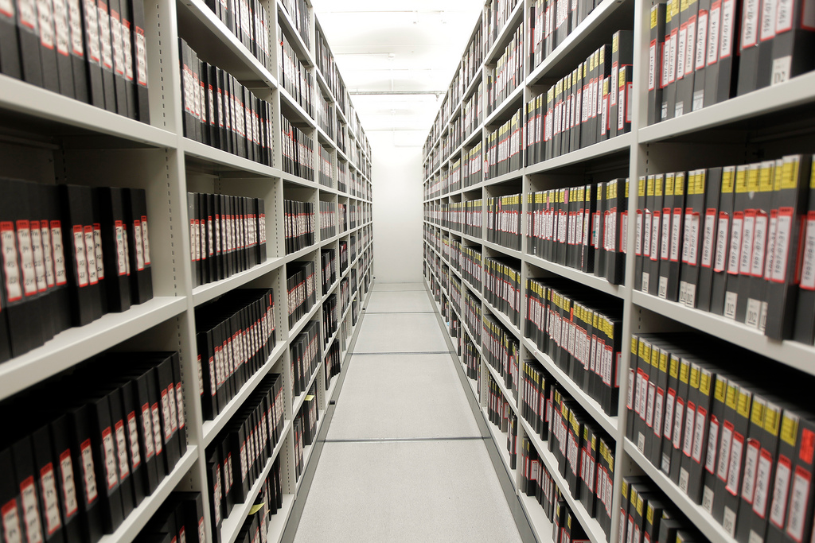
Records Management
Key components of records management include:
Classification and organization;
Retention and Disposition;
17

Slide 18
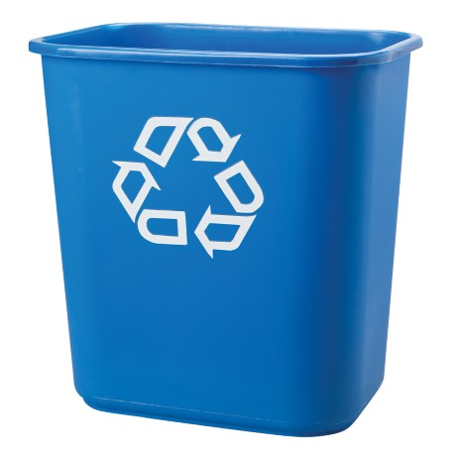
What Can we Get Rid Of?
Records that have meet their
Retention schedule
Approved schedules
Surplus records & Transitory records
Duplicate/convenience copies
Drafts and working copies
Non-work related records
Personal things employees do at work

Slide 19
Questions? Thoughts?

